Slide 1
Simple and Useful Crypto Dashboard
By: Rafael Sy, Emmanuel Constant, Ludovic Schneider, Lucas Shaiman, Juan Izquierdo Teran, and Patty Y

Slide 2
Agenda
What is it?
Visual Tools and Resources
How it works
Looking ahead
Sources and Dependencies used

Slide 3
What is it?
A dashboard that will give you a snapshot of useful and relevant data to make the best educated decisions when it comes to your Crypto portfolio - all in one place:
Showcase coin asset information
Provide visuals of helpful indicators so users can plan ahead
Showcase asset holdings and sharpe ratios
Show transaction history and progress from initial transaction
Provide snapshots of certain markets to compare and contrast
Track performance of overall portfolio

Slide 4
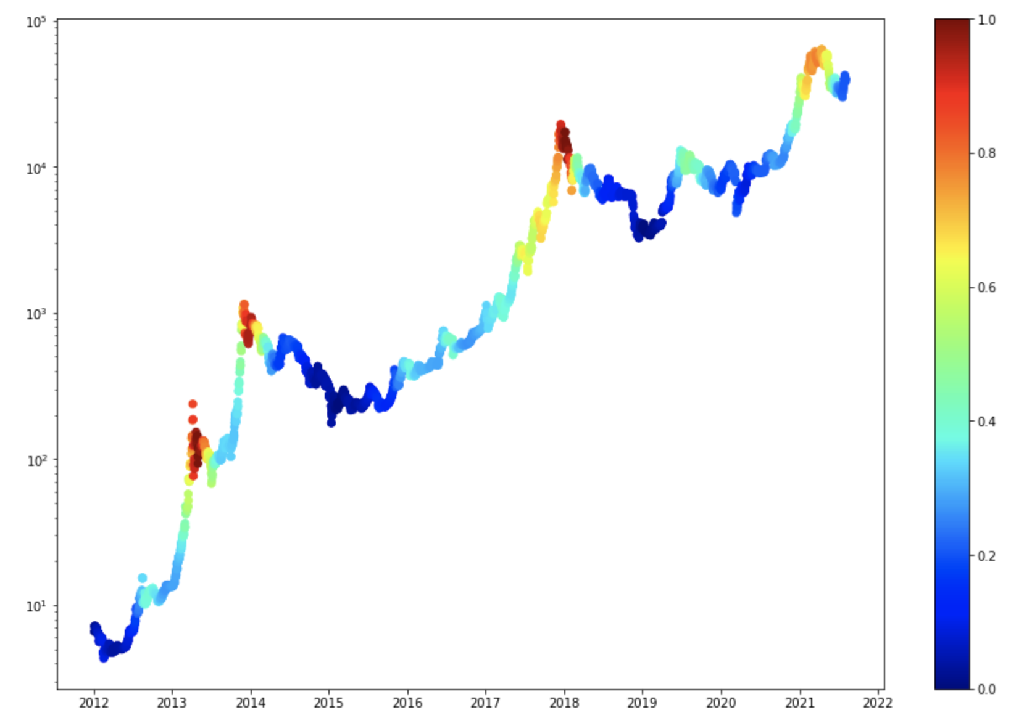
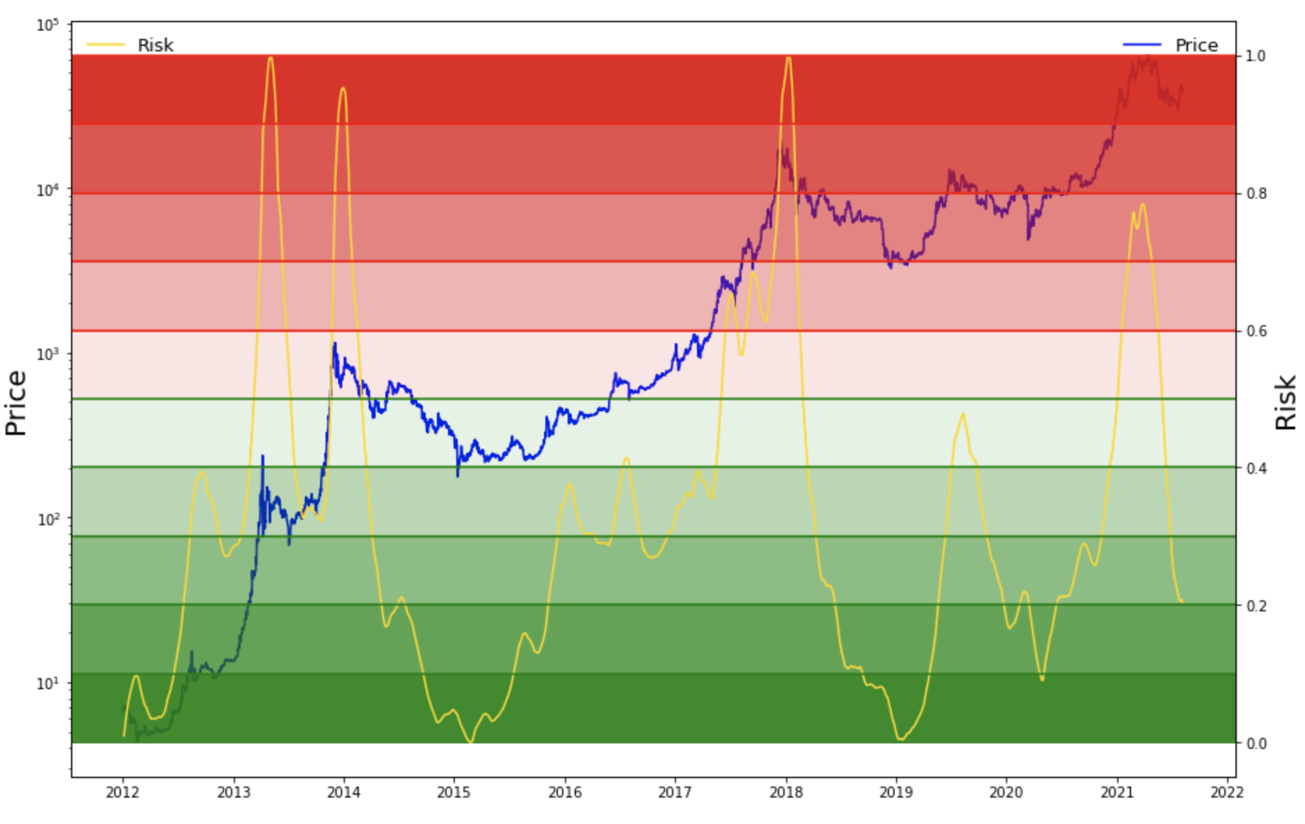
Visual Tools and Resources: Dollar Cost Averaging Heatmap and Dollar Cost Averaging Tool
As the price of BTC enters a new threshold represented by the color changes that will show you what you should look to do next*
Example: as the price enters a red zone that is a signal to the user to begin selling off, weekly.
Vice Versa: as the price transitions to the blue threshold, begin buying, weekly.

Slide 5
How it works
Using Panel we were able to get all of our graphs in a panel dashboard for easy navigation
We can also pull in your portfolio directly from Coinbase to further evaluate your Coinbase holdings
Over time we plan on using Zapper API to fully incorporate DeFi and NFT assets and build out useful metrics to derive information from

Slide 6
Looking Ahead
“Plug and play compatibility” along with further development of tools such as:
Yield Farming Options
Staking Options
Separating Accounts by “buckets” (i.e. Savings, Trading, Staking, NFTs, etc)
News feed with relevant news headlines
Market Movers (winners / losers of the day)
Full DeFi and NFT showcase using Zapper API
Be able to handle multiple wallets from other sources

Slide 7

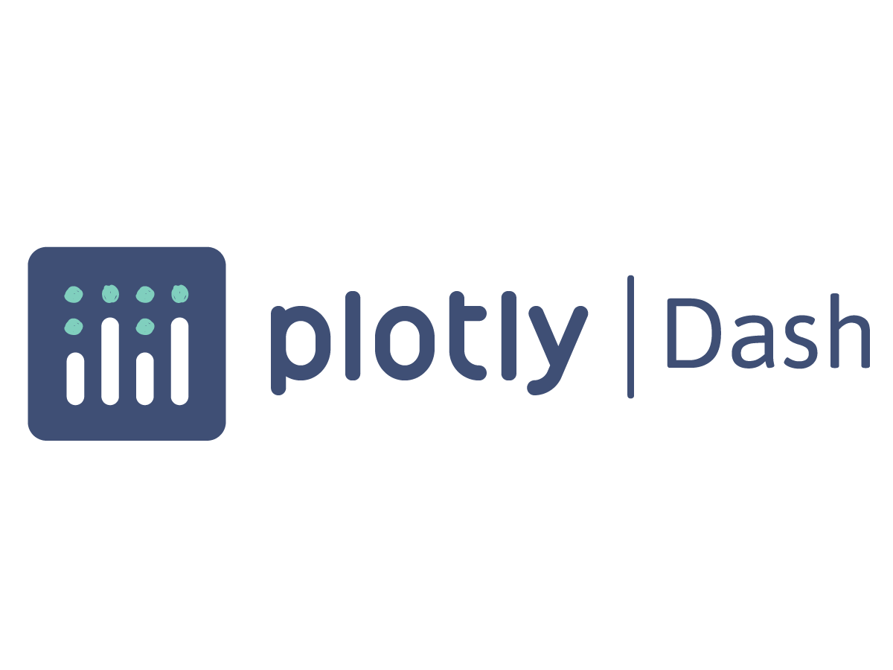
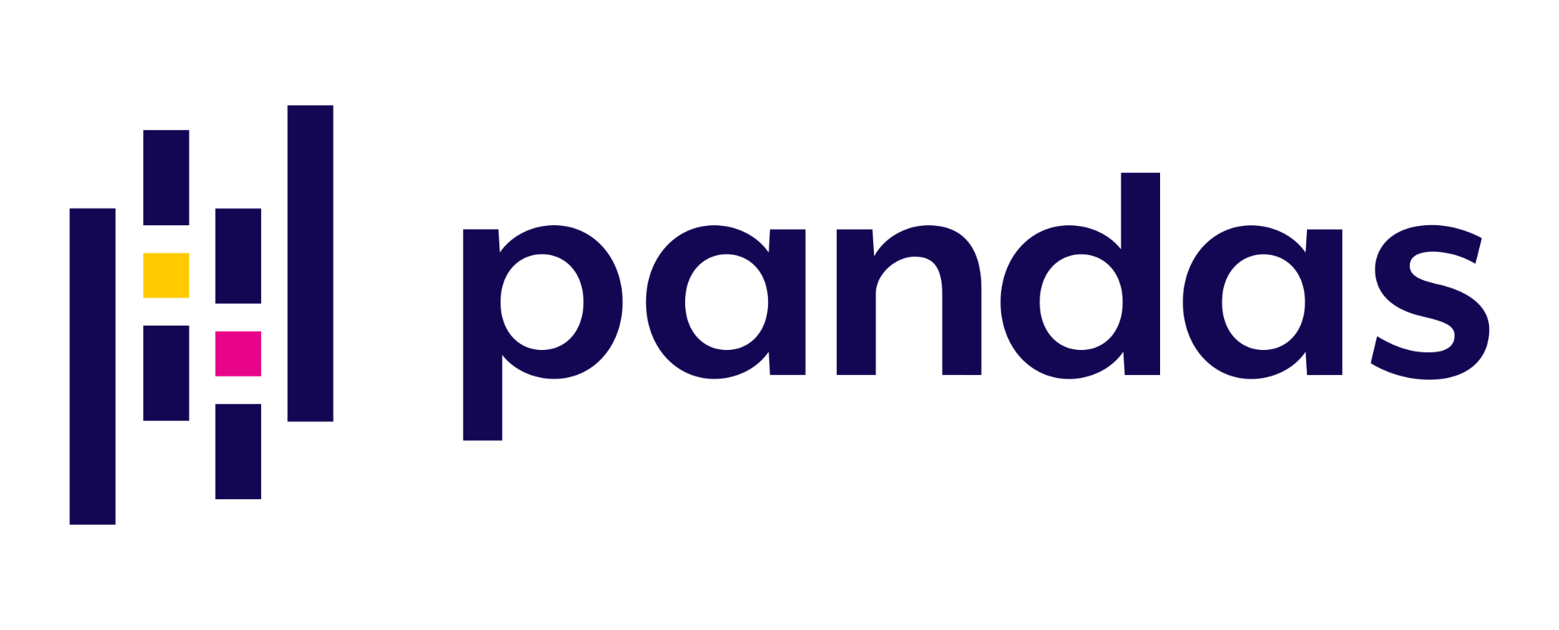


Sources and Dependencies Used
Benjamin Cowen - Youtube Channel
Bitcoin Logarithmic Regression Tutorial - Chad Thackray
Coinbase API
CoinGecko API
Simple Portfolio Tracker with Dash, Plotly, and Bootstrap
Zapper API
Yahoo Finance API

